Slide 1


PC2: Pseudo-Classification Based Pseudo-Captioning for
Noisy Correspondence Learning in Cross-Modal Retrieval
Yue Duan¹², Zhangxuan Gu², Zhenzhe Ying², Lei Qi³ , Changhua Meng², and Yinghuan Shi¹
¹ Nanjing University, China ² Ant Group, China ³ Southeast University, China
论文链接：https://arxiv.org/pdf/2408.01349
项目链接：https://github.com/alipay/PC2-NoiseofWeb
数据集: https://huggingface.co/datasets/NJUyued/NoW
知乎: https://zhuanlan.zhihu.com/p/711149124

Slide 2
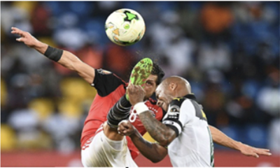
PC2: Pseudo-Classification Based Pseudo-Captioning for Noisy Correspondence Learning in Cross-Modal Retrieval
Cross-Modal Retrieval
soccer player is beaten to the ball by the soccer player
Image
Encoder
Similarity
Measurement
Text
Encoder

Slide 3
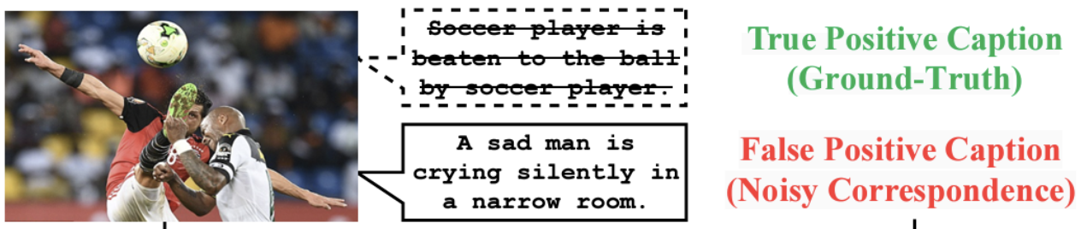
PC2: Pseudo-Classification Based Pseudo-Captioning for Noisy Correspondence Learning in Cross-Modal Retrieval
Introduction
当前跨模态图文检索模型依赖于精确配对的图像文本对
人工标注图文对费时费力，而自动收集的数据存在噪声对应
在具有噪声对应的环境下训练得到鲁棒的跨模态检索模型

Slide 4
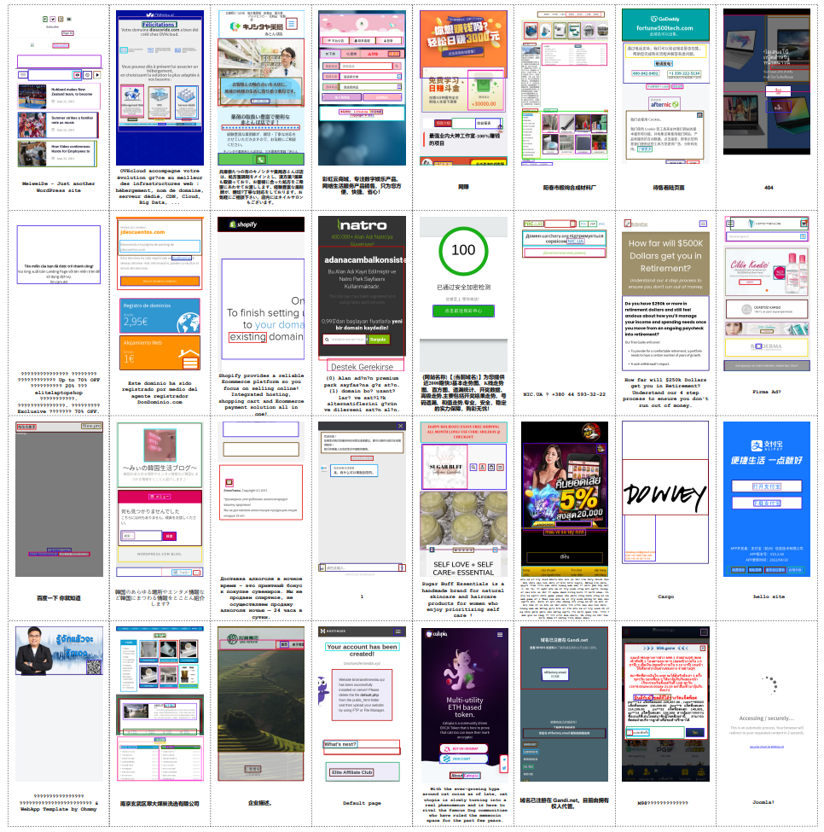
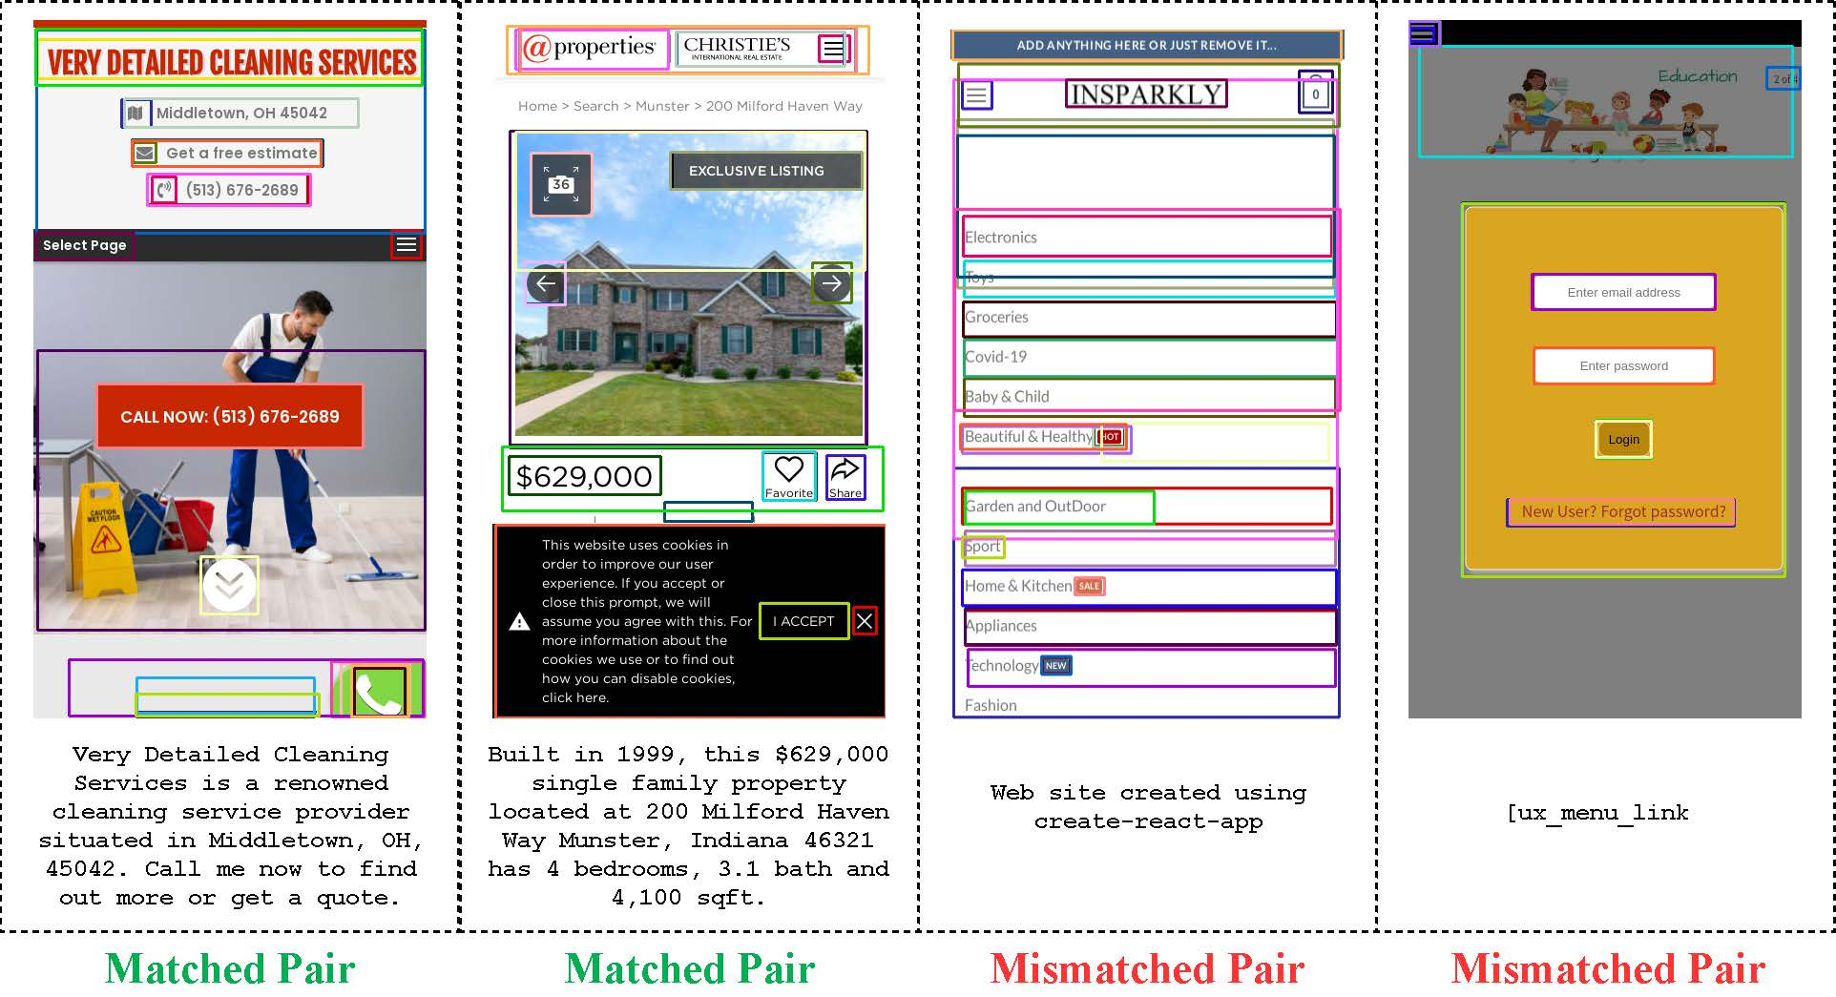
PC2: Pseudo-Classification Based Pseudo-Captioning for Noisy Correspondence Learning in Cross-Modal Retrieval
Dataset Contribution – Noise of Web (NoW)
过往 NCL 研究主要基于人工模拟的数据集进行评测，我们提出一个真实业务环境下收集的NCL数据集
该数据集包含了 100,000 个直接从网页环境中提取的【网页截图（图像）-元描述（文本）】数据对
98,000 对用于训练，1,000 对用于验证，1000对用于测试

Slide 5
PC2: Pseudo-Classification Based Pseudo-Captioning for Noisy Correspondence Learning in Cross-Modal Retrieval
Dataset Contribution - Noise of Web (NoW)
图像部分是通过获取移动设备浏览网页时的屏幕截图（分辨率为720x1280）得到的。
我们从每张图像的前36个检测区域中提取得到特征，最终每张图像被表示为一个36x768的特征矩阵。
文本部分则直接来源于网页 HTML 源代码中的元描述（meta description）字段。
NoW 的噪声比例接近 70%

Slide 6
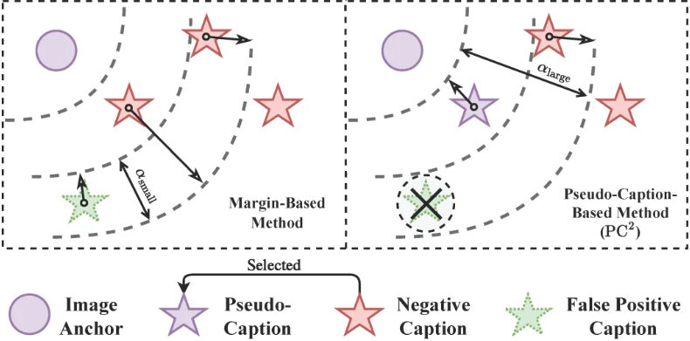
PC2: Pseudo-Classification Based Pseudo-Captioning for Noisy Correspondence Learning in Cross-Modal Retrieval
Motivation
既往的NCL解决方案多采用微调三元组损失（triplet ranking loss）中的软边距（soft margin）策略，以减轻不匹配数据对训练过程中的负面影响
它们未能直接为假阳性数据对提供有益的监督信号，仅是削弱了错误监督的负面效应

Slide 7
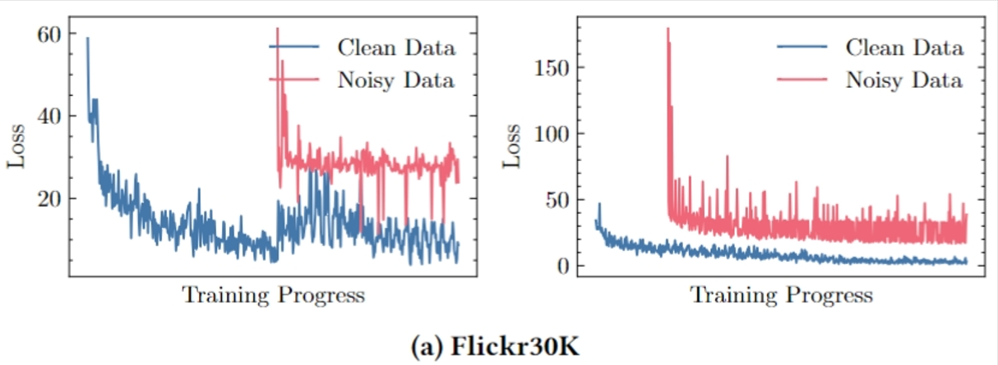
PC2: Pseudo-Classification Based Pseudo-Captioning for Noisy Correspondence Learning in Cross-Modal Retrieval
Motivation
即便这些方法力求抵御噪声干扰，其训练过程仍显著受制于噪声数据，导致损失曲线波动剧烈
应当从不同的角度加强对于干净数据的学习

Slide 8
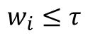
PC2: Pseudo-Classification Based Pseudo-Captioning for Noisy Correspondence Learning in Cross-Modal Retrieval
Overview
本文提出了一种名为“基于伪分类的伪标题方法”
旨在跨模态检索模型训练中为所有噪声数据提供切实有效的监督
Memorization Effect Based Data Division
soccer player is beaten to the ball by the soccer player
$$w_{i}≤τ$$
Two
Component
GMM
Noisy
Data
Clean
Data

Slide 9
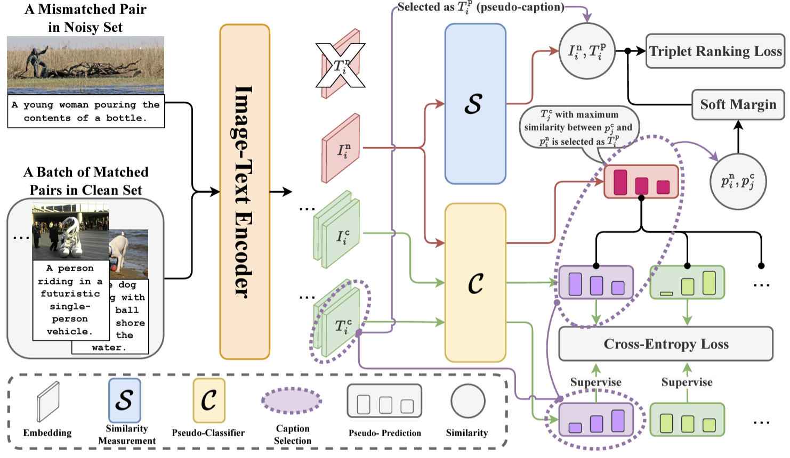
PC2: Pseudo-Classification Based Pseudo-Captioning for Noisy Correspondence Learning in Cross-Modal Retrieval
Method - PC²
PC²框架可理解为下面三个模块组成的集成解决方案：
伪分类
基于伪分类的伪标签生成
基于预测震荡的对应关系矫正

Slide 10
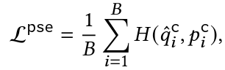
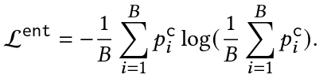
PC2: Pseudo-Classification Based Pseudo-Captioning for Noisy Correspondence Learning in Cross-Modal Retrieval
Method - Pseudo-Classification
伪分类：利用伪分类器以图像为anchor将视觉语义聚类分组为K个伪类
作用：以非对比学习的方式强化模态对齐
Cross-entropy loss
Entropy loss
按设定的通道数将视觉语义按簇分组学习
后续利用伪分类能力为噪声图像分配伪标题

Slide 11
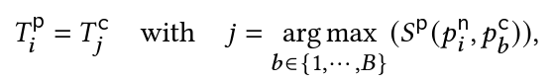
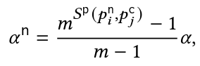
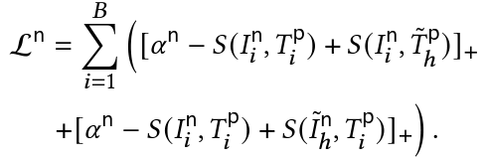
PC2: Pseudo-Classification Based Pseudo-Captioning for Noisy Correspondence Learning in Cross-Modal Retrieval
Method - Pseudo-Captioning
伪标题：利用伪分类器对干净图像以及噪声图像的伪预测的相似程度分配伪标题
作用：为噪声图像提供正确监督
具有最相似伪预测的干净图像的标题
分配为对应噪声图像的伪标题

Slide 12
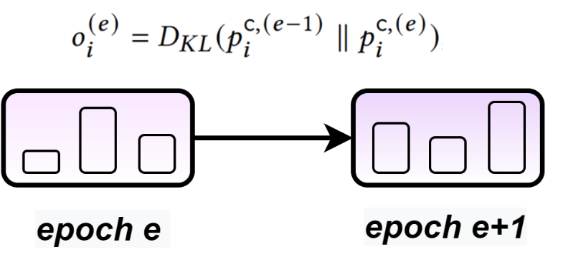
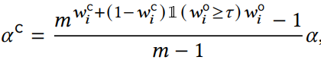
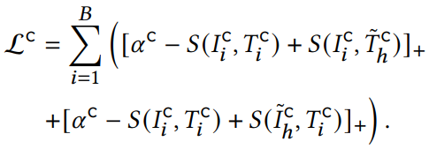
PC2: Pseudo-Classification Based Pseudo-Captioning for Noisy Correspondence Learning in Cross-Modal Retrieval
Method - Prediction Oscillation Based Correspondence Rectification
从基于具有正确对应关系的标题的伪标签中学习到的图像伪分类结果应该是稳定的
即震荡的伪预测表示[图像-标题]对中的对应性较低
使用GMM拟合后输出干净概率

Slide 13
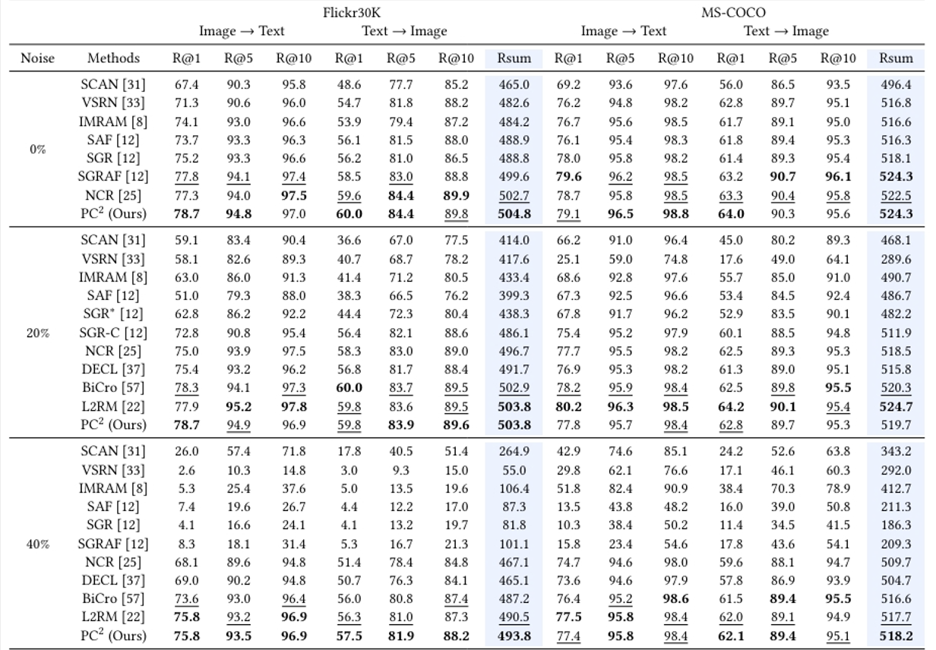
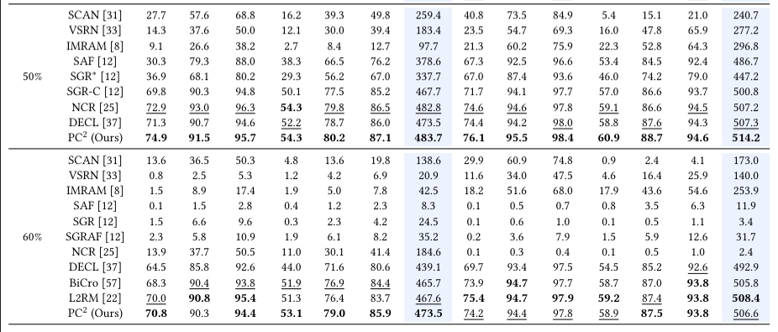
PC2: Pseudo-Classification Based Pseudo-Captioning for Noisy Correspondence Learning in Cross-Modal Retrieval
Experiment - Flickr30K, MS-COCO
在Flickr30K和MS-COCO上的召回率R@1，R@5，R10以及Rsum的性能比较

Slide 14
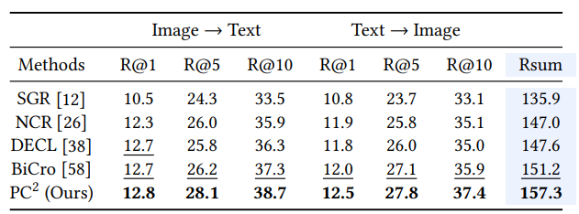
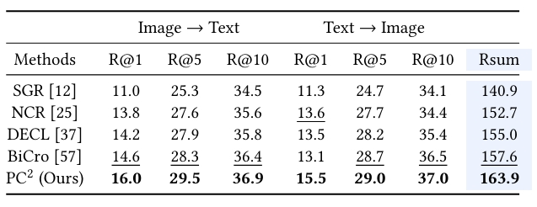
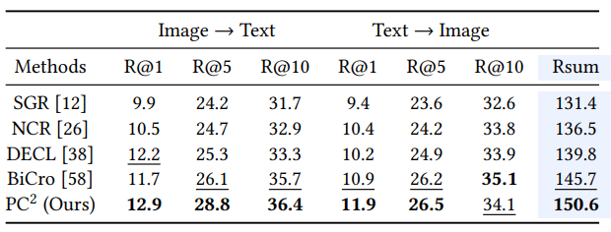
PC2: Pseudo-Classification Based Pseudo-Captioning for Noisy Correspondence Learning in Cross-Modal Retrieval
Experiment - Flickr30K, MS-COCO
在NoW上的召回率R@1，R@5，R10以及Rsum的性能比较
考虑到虽然NoW为多语言数据集，其中包括中文，英文，日文，俄文等，但中文占主体，我们首先使用Jieba分词器对文本进行分词，同时我们也提供了使用BPETokenizer以及预训练的BertTokenizer进行分词的数据版本
BPETokenizer
BertTokenizer
Jieba

Slide 15
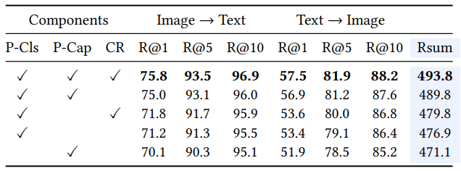
PC2: Pseudo-Classification Based Pseudo-Captioning for Noisy Correspondence Learning in Cross-Modal Retrieval
Experiment - Ablation Study
我们验证了PC²中各个组件的有效性
其中P-Cls为伪分类模块，P-Cap为基于伪分类的伪标题生成模块以及CR为基于预测震荡的对应关系矫正模块。

Slide 16




Thanks!
论文链接：https://arxiv.org/pdf/2408.01349
项目链接：https://github.com/alipay/PC2-NoiseofWeb
数据集: https://huggingface.co/datasets/NJUyued/NoW
知乎: https://zhuanlan.zhihu.com/p/711149124

Slide 17

欢迎加入机智流

